Slide 1
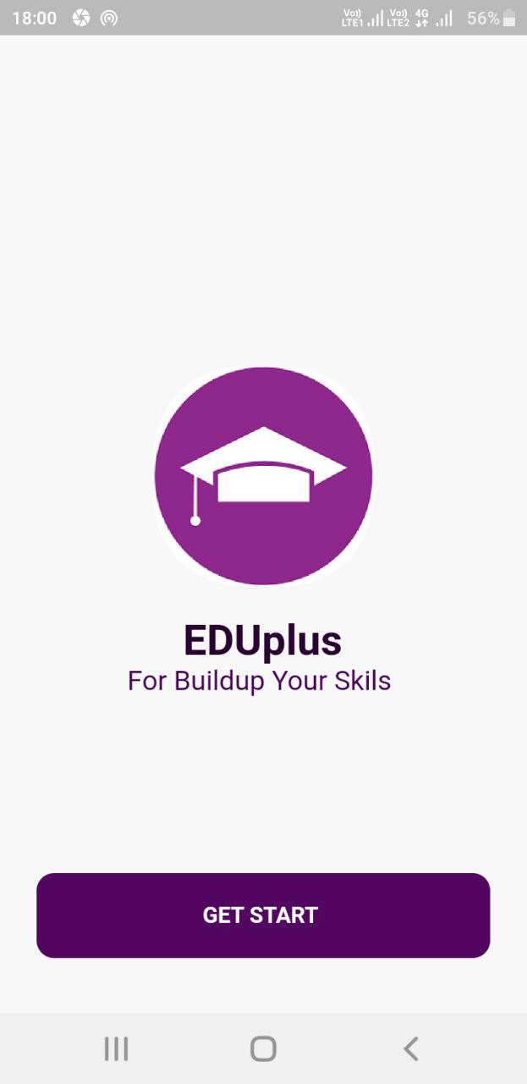
Course Learning
App
Anu/it/2021/f/91
Group - b

Slide 2
Introduction
The “ Eduplus” is Online Learning Courses App it is designed for student to enhance the online learning experience by offering a versatile and intuitive platform for participating in courses.

Slide 3
AIMs and Objective
AIM
The primary focus is to facilitate interactive assessments that promote knowledge retention and engagement.

Slide 4
Object
To start attending the quiz, read pdf, join the live zoom session and you tube video in the subject categories.
To participate for the exam quiz.
To generate unique certificate for students.
To create a user-friendly interface.

Slide 5



Use Technologies

Slide 6
Future Work
Hope to make all users can download their certificate like a pdf.
Hope to develop a stage to all users can present their problems.
Hoping to develop courses in any language for all users

Slide 7
Demonstration

